Slide 1
an algorithm
Solving a puzzle with
Notes:
puzzle puzzle!

Slide 2
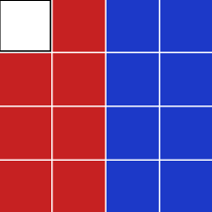
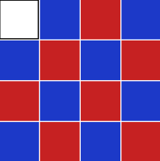
The rules
The rules
SWAP: when never you move the white block, it will swap with other block.
GOAL: is to find the shortest way to make those blocks in this order.
EXAMPLE: if white block moved right, it would swap with the red block on the right.

Slide 3

The problem
the problem
How: make right order
How: find shortest path
What: algorithm / data structure
Notes:
It is very easy to make question one happens.
How to make blocks into that order
How to find the shortest way
Is there an algorithm or data structure for that?

Slide 4
right order LOL
the problem
Find a 📜
Grab a ✏️
Oh don’t forget ✂️
Notes:
Play with it

Slide 5
the algorithm & data structure
the algorithm & data structure
Graph
BFS
DFS
Notes:
Let’s go back to school

Slide 6
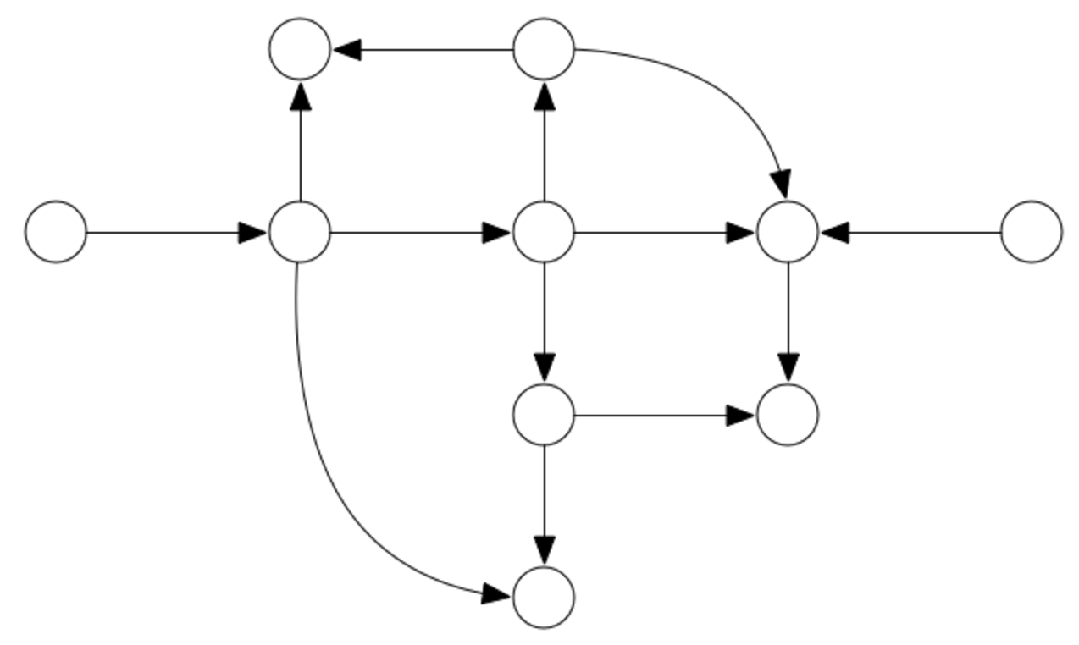
Graph
the algorithm & data structure
If you have some programming problem where you can represent some of your data as vertices and some of it as edges between those vertices, then you can draw your problem as a graph and use well-known graph algorithms such as breadth-first search or depth-first search to find a solution.

Slide 7
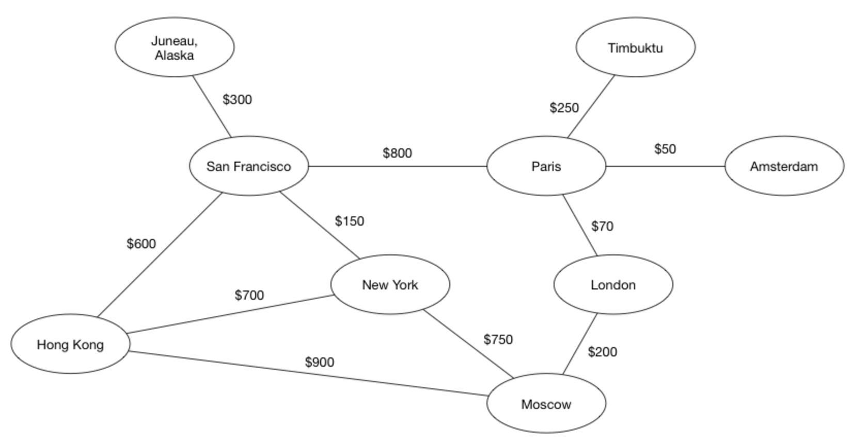
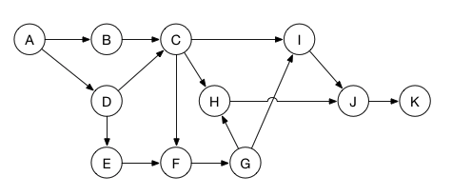
the algorithm & data structure
Notes:
is graph a good idea?
is graph make sense to solve the problem?
our data structure is already simple enough
It is not only to find the shortest path but also make blocks into the right order.

Slide 8
the problem
W
W
W
Step 1
Step 2
Step 3
After 2N steps
?
W
…..
Step 2N
Notes:
Step changes, understand rules, why is it 2n steps
It is not to find the right path but also make block into the right order.
Method of exhaustion? BFS / DFS?
Performance: a. duplicated steps, b. dead end, 3. multiple results
a and b, create frame
What is frame, what is frame for?

Slide 9
what is bfs
the algorithm & data structure
Breadth-first search is a method for traversing a tree or graph data structure. It starts at a source node and explores the immediate neighbor nodes first, before moving to the next level neighbors. As a convenient side effect, it automatically computes the shortest path between a source node and each of the other nodes in the tree or graph.
Notes:
Read

Slide 10
what is dfs
the algorithm & data structure
Depth-first search (DFS) is an algorithm for traversing or searching tree or graph data structures. It starts at a source node and explores as far as possible along each branch before backtracking.Depth-first search can be used on both directed and undirected graphs.

Slide 11

What is BFS good for?
the algorithm & data structure
Breadth-first search can be used to solve many problems. A small selection:
Computing the shortest path between a source node and each of the other nodes (only for unweighted graphs).
Calculating the minimum spanning tree on an unweighted graph.
Written by Chris Pilcher and Matthijs Hollemans
Notes:
Read

Slide 12
what is dfs good for?
the algorithm & data structure
Depth-first search can be used to solve many problems, for example:
Finding connected components of a sparse graph
Topological sorting of nodes in a graph
Finding bridges of a graph (see: Bridges)
And lots of others!
Written for Swift Algorithm Club by Paulo Tanaka and Matthijs Hollemans

Slide 13
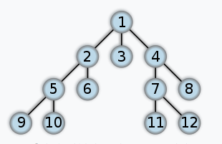
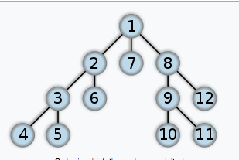
traverse order
the algorithm & data structure
How BFS traverses a graph
How DFS traverses a graph
Notes:
The big difference is traverse order
Ask questions:
Can we use graph and BFS to solve this puzzle?
Is it worth it? Is it possible

Slide 14
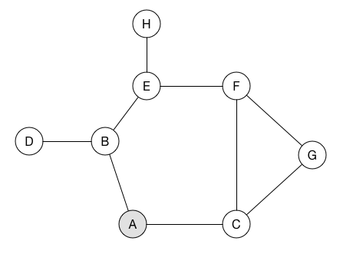
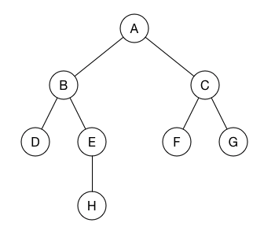
Find shortest path
the algorithm & data structure
Start from A
Then traverse the graph in BFS
The order is:
A, B, C, D, E, F, G, H
Notes:
How is that gonna help me to find the shortest path?
Let’s play with it
Method of exhaustion? BFS / DFS?

Slide 15
the solution
W
W
W
Step 1
Step 2
Step 3
After 2N steps
?
W
…..
Step 2N
Notes:
Step changes, understand rules, why is it 2n steps
It is not to find the right path but also make block into the right order.
Method of exhaustion? BFS / DFS?
Performance: a. duplicated steps, b. dead end, 3. multiple results
a and b, create frame
What is frame, what is frame for?

Slide 16
the solution
The solution
W
R1
R2
R1
R2
W
R3
R3
W
B3
R4
R5
Step 1
Step 2
Step 3
Dead end
❌
Frame array 1
R1
R2
Frame array 2
R2
R4
R3
Frame array 3
R1
R5
R3
B3
Step 2N
Notes:
Step changes, understand rules, why is it 2n steps
It is not to find the right path but also make block into the right order.
Method of exhaustion? BFS / DFS?
Performance: a. duplicated steps, b. dead end, 3. multiple results
a and b, create frame

Slide 17
Duplicated step
the solution
None
Down
Right
Left
W
W
W
W
Step 1
Step 2
Step 3
Step 4
Notes:
Performance: duplicated steps, same result

Slide 18
Dead end step
The solution
None
Right
Left
Right
W
W
W
W
Step 1
Step 2
Step 3
Step 4
Notes:
dead end,
a and b, create frame

Slide 19
frame
The solution
W
❌
W
W
W
Frame 1
Frame 2
Frame 3
Frame 4
frame 1, count 0
frame 2, count 1
frame 3, count 2
.
.
.
frame n, count n
Frame 4 == Frame 2, steps count 3 >= steps count 1
Dictionary <Frame, StepCount>

Slide 20
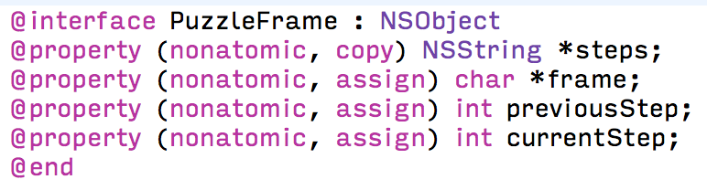
frame model
the solution

Slide 21
improved results
the solution
Frames before: 10,000,000 +
Frames after: 102960

Slide 22
useful resources
Resources
https://github.com/raywenderlich/swift-algorithm-club/tree/master/Graph
https://github.com/raywenderlich/swift-algorithm-club/tree/master/Breadth-First%20Search
https://github.com/raywenderlich/swift-algorithm-club/tree/master/Depth-First%20Search
https://github.com/LawrenceHan/Puzzle-iOS

Slide 23

seeking excellent
Lawrence
Notes:
Wait, one more thing.

Slide 24
multiple results
the solution
W
W
W
Route 1
Step 1
Step 2
Step 3
W
❌
W
W
Route 2
Step 1
Step 2
Step 3
Notes:
Different steps, same results

Slide 25
improved iteration times
The solution
Iterating 32th step (last step)
Before: 618108
After: 25400

Slide 26
Multi-threading (Hello again)
Multi-threading
NSOperation
GCD
NSThread
NSRunloop
Pthread

Slide 27
producer & consumer model
Multi-threading

